Slide 1

Green Pace
Security Policy Presentation
Developer: Mark Baligad
CS 405 Secure Coding
12/14/2025

Slide 2

OVERVIEW: DEFENSE IN DEPTH
The Security Policy exists to protect the organizations systems, data, and reputation.
The policy mandates multiple, overlapping security layers so no single failure results in compromise.
The layered security model focuses on critical assets in the middle, technical enforcement in the inner layers, and organizational resilience in the outer layers.

Slide 3
THREATS MATRIX
Likely STD-003-CPP | Priority STD-002-CPP STD-004-CPP STD-005-CPP STD-009-CPP
Low priority STD-008-CPP STD-006-CPP STD-010-CPP | Unlikely STD-001-CPP STD-007-CPP
Priority indicates the order in which vulnerabilities should be addressed.
Likeliness indicates the probability this threat would be exploited by an attacker.

Slide 4
10 PRINCIPLES
Principles | Description
1. Validate Input Data | Ensure all incoming data is checked and safe before use to prevent issues such as injection or buffer overflow.
2. Heed Compiler Warnings | Fix compiler warnings early to avoid vulnerabilities.
3. Architect and Design for Security Policies | Build security into the system from the start so access, data flow, and threat response remain consistent and controlled.
4. Keep It Simple | Simple code is easier to secure, test, and maintain. Less complexity reduces chances for errors and hidden vulnerabilities.
5. Default Deny | Start with no access granted and open only what is needed. Restrictive defaults reduce exposure and limit attack paths.

Slide 5
10 PRINCIPLES
Principles | Description
6. Adhere to the Principle of Least Privilege | Give users and processes only the minimal permissions required. Limits damage if a component is compromised.
7. Sanitize Data Sent to Other Systems | Clean and validate data before sending it across system boundaries to prevent misuse or command injection.
8. Practice Defense in Depth | Use multiple layers of security so that if one fails, others still protect the system.
9. Use Effective Quality Assurance Techniques | Use testing, reviews, and static analysis to catch security and functional issues early in development.
10. Adopt a Secure Coding Standard | Follow consistent secure coding rules to reduce mistakes, prevent risky functions, and ensure predictable, safe behavior.

Slide 6
CODING STANDARDS
Rule | Priority | Description
STD-001-CPP | High (P12) | Ensure that integer conversions do not result in lost or misinterpreted data.
STD-002-CPP | High (P9) | Ensure that unsigned integer operations do not wrap.
STD-004-CPP | High (P9) | String data cannot be misinterpreted as commands or control characters.
STD-005-CPP | High (P9) | Do not access freed memory.
STD-009-CPP | High (P9) | Properly deallocate dynamically allocated resources.
STD-007-CPP | Medium (P6) | Handle all exceptions.
STD-003-CPP | Low (P3) | Storage for strings has sufficient space for character data and null terminator.
STD-010-CPP | Low (P3) | Range check element access.
STD-006-CPP | Low (P2) | Avoid side effects in arguments to unsafe macros.
STD-008-CPP | Low (P2) | Do not leak resources when handling exceptions.

Slide 7
ENCRYPTION POLICIES
Encryption at Rest | Protects stored data using strong encryption. Applied to databases, backups, and local file storage. Ensures stolen or accessed data remains unreadable.
Encryption in Flight | Secures data as it moves between systems. Prevents interception or tampering during transmission. Applied to API calls, login requests, client–server communication.
Encryption in Use | Protects sensitive data while in memory. Secure memory handling, access controls, and runtime safeguards. Prevent memory scraping, injection, or compromised processes.

Slide 8
TRIPLE-A POLICIES
Authentication | Verify user and system identities using strong methods (password rules, MFA, certificates).
Authorization | Enforce least-privilege access so users and processes can only perform approved actions.
Accounting | Log and monitor activity to track changes, detect misuse, and support audits.

Slide 9
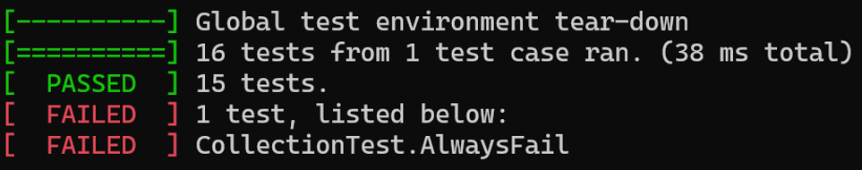
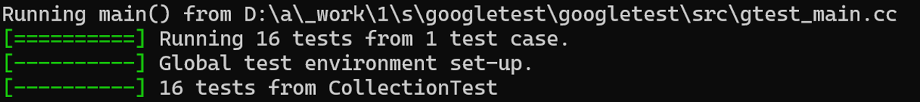
Unit Testing Overview
Testing focuses on detecting buffer overflow and unsafe string handling vulnerabilities.
Unit tests verify correct behavior for valid inputs and confirm failures occur safely for invalid inputs.
Tests use the Google Test Framework.
Supports the policy requirement to detect vulnerabilities before deployment.

Slide 10
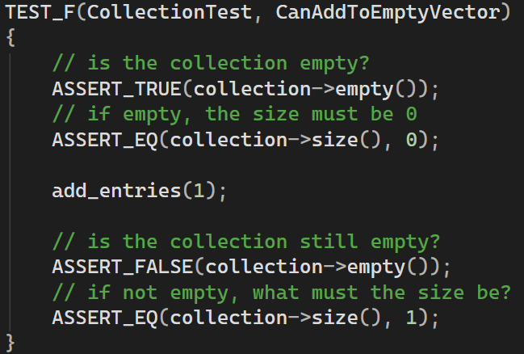
Unit Testing: CanAddToEmptyVector
Positive test that verifies that adding entries to an empty collection increases the size of the collection.

Slide 11
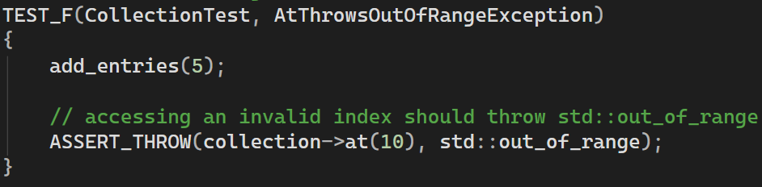
Unit Testing: AtThrowsOutOfRangeException
Negative test that verifies the at() method throws an exception for an invalid index.

Slide 12
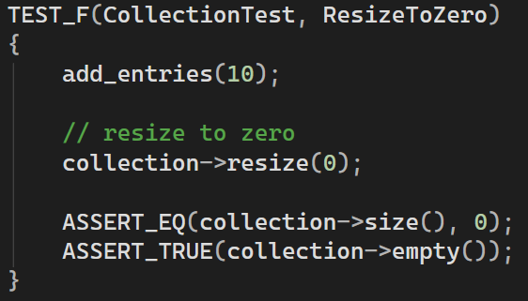
Unit Testing: ResizeToZero
Positive Test that verifies that resizing a collection to zero empties the collection.

Slide 13
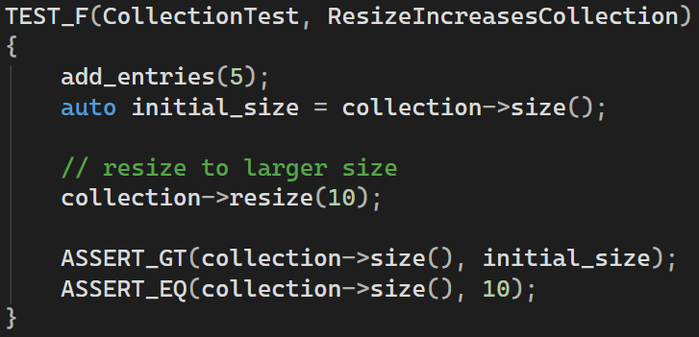
Unit Testing: ResizeIncreasesCollection
Positive test that verifies that the resize() method increases the collection size when the new size is greater than the initial size.

Slide 14
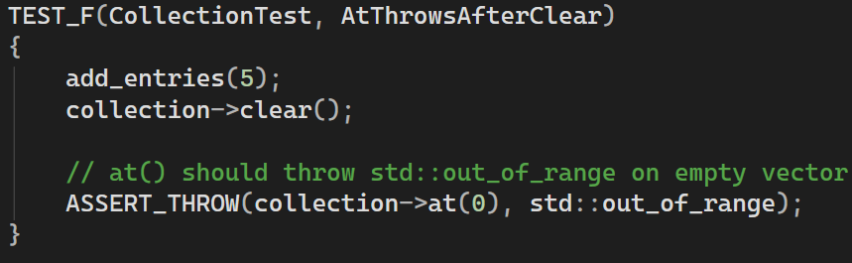
Unit Testing: AtThrowsAfterClear
Negative test that verifies that the at() method throws an out_of_range exception after clearing the collection.

Slide 15

AUTOMATION SUMMARY

Slide 16
TOOLS
Phase | Component | Description
Pre-Production | Assess and Plan | Threat modeling and risk assessment are used to identify high-priority vulnerabilities and determine where automation and testing are required.
 | Design | System architecture is designed using secure design principles such as defense in depth and least privilege.
 | Build | Developers use secure IDE configurations and compilers with warnings enabled.
 | Verify and Test | Automated unit testing and static code analysis tools are executed to detect vulnerabilities such as buffer overflows and unsafe memory usage.
Production | Transition and Health Check | Security checks are performed during deployment to ensure configurations, permissions, and encryption settings match policy requirements before the application goes live.
 | Monitor and Detect | Logging and monitoring tools track application behavior and system activity in real time.
 | Respond | Incident response procedures are triggered when security events are detected. Logs and audit data support investigation, containment, and remediation of identified issues.
 | Maintain and Stabilize | Ongoing maintenance includes applying patches, updating dependencies, and refining automated tests and security tools.

Slide 17
RISKS AND BENEFITS
 | Pros | Cons
Early Security Implementation | Lower long-term remediation and maintenance costs. Improves code consistency and reliability. Fewer vulnerabilities introduced over time. | Requires a higher upfront planning and development effort. May be slower to reach development milestones. Requires developer training and process changes.
Late Security Implementation | Faster initial development and feature delivery. Lower upfront development costs. Fewer process constraints. | Higher risk of exploitable vulnerabilities in production. Retrofitting security to an existing system is more complex and expensive. Harder to enforce consistent security standards. May require emergency fixes and unplanned downtime.

Slide 18
RECOMMENDATIONS
Expand Automation Coverage
Increase automated enforcement beyond unit testing by integrating static analysis and dependency scanning earlier in the DevSecOps pipeline.
Formalize Secure Coding Training
Provide recurring training on secure coding standards to ensure developers consistently understand and apply the security policy.
Strengthen Policy Enforcement Metrics
Track policy compliance using measurable indicators such as failed builds, test coverage, and vulnerability trends.
Enhance Continuous Monitoring
Improve logging, alerting, and audit capabilities to detect security issues post-deployment and support faster incident response.

Slide 19
CONCLUSIONS
The Green Pace security policy establishes a strong foundation by defining clear secure coding standards and risk prioritization.
Applying security controls early in the development lifecycle reduces vulnerabilities and lowers remediation costs.
Automated testing, static analysis, and monitoring work together to enforce the policy and support defense in depth.
Continuous improvement and training are essential to ensure the policy remains effective as systems and threats evolve.

Slide 20
REFERENCES
Dunham, R. (2021, October 26). Information Security Policies: Why they are important to your organization. Linford & Company LLP. https://linfordco.com/blog/information-security-policies/
Red Hat Enterprise Linux. (2013, February 14). Red Hat Secure Programming Series 1: Input Validation (part 1 of 2) [Video]. YouTube. https://www.youtube.com/watch?v=1bq0MJ5lV5c
Seacord, R. C. (2013). Secure Coding in C and C++ (2nd ed.). Pearson Technology Group. https://mbsdirect.vitalsource.com/books/9780132981972
SEI CERT C++ Coding Standard - SEI CERT C++ Coding Standard - Confluence. (n.d.). https://wiki.sei.cmu.edu/confluence/pages/viewpage.action?pageId=88046682
Start with Security: A Guide for Business. (2024, February 14). Federal Trade Commission. https://www.ftc.gov/business-guidance/resources/start-security-guide-business

